Slide 1

Predicting Airbnb Prices
New York
Composed by Group 06
__________________
Keya Mankar
Revathi Srirangam
Jay Sethia
Ankit Yadav

Slide 2
Executive Summary
Goal: Predict Airbnb house prices in New York City
Help hosts understand underlying pricing dynamics
Predict the optimal listing price for guests and hosts

Slide 3
Data Description
Data Obtained from : Inside Airbnb
Two primary files: listings.csv reviews.csv
Initial data set: 106 variables ~48,000 observations

Slide 4
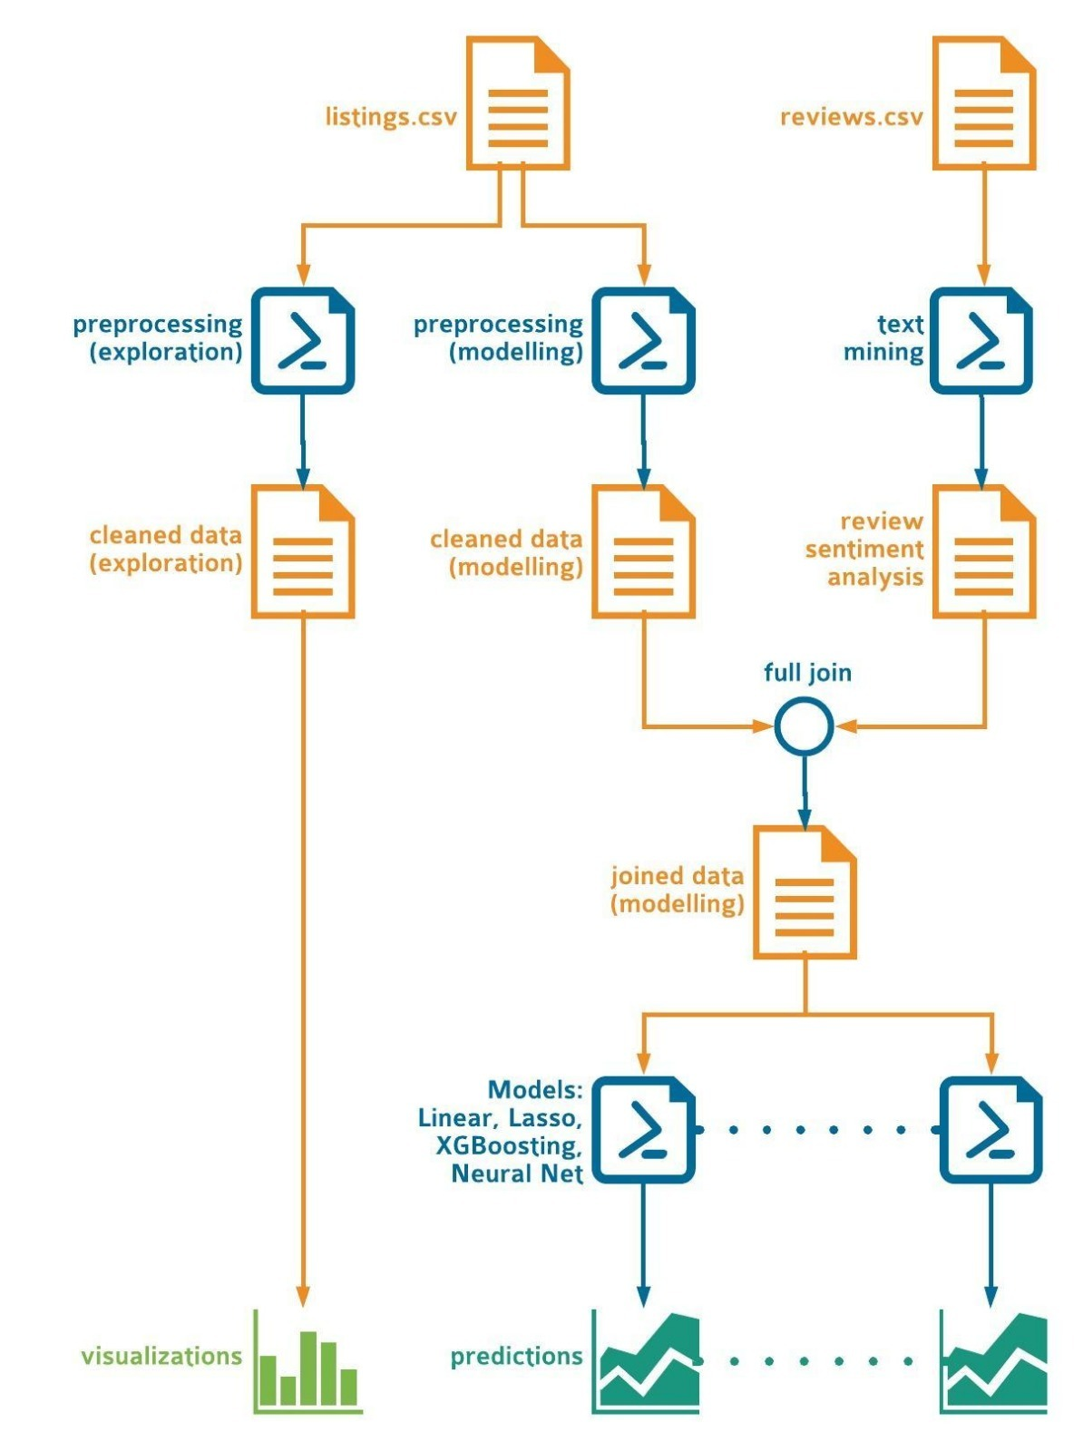
Workflow

Slide 5
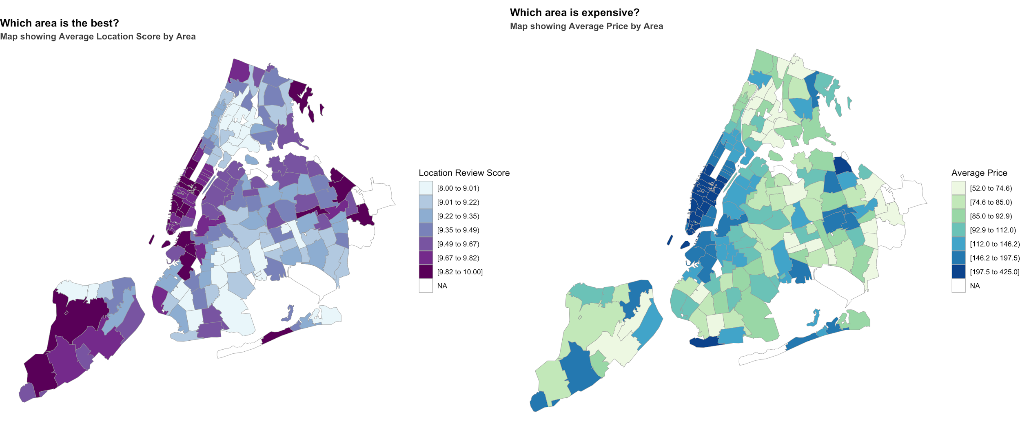
NYC Heatmap

Slide 6
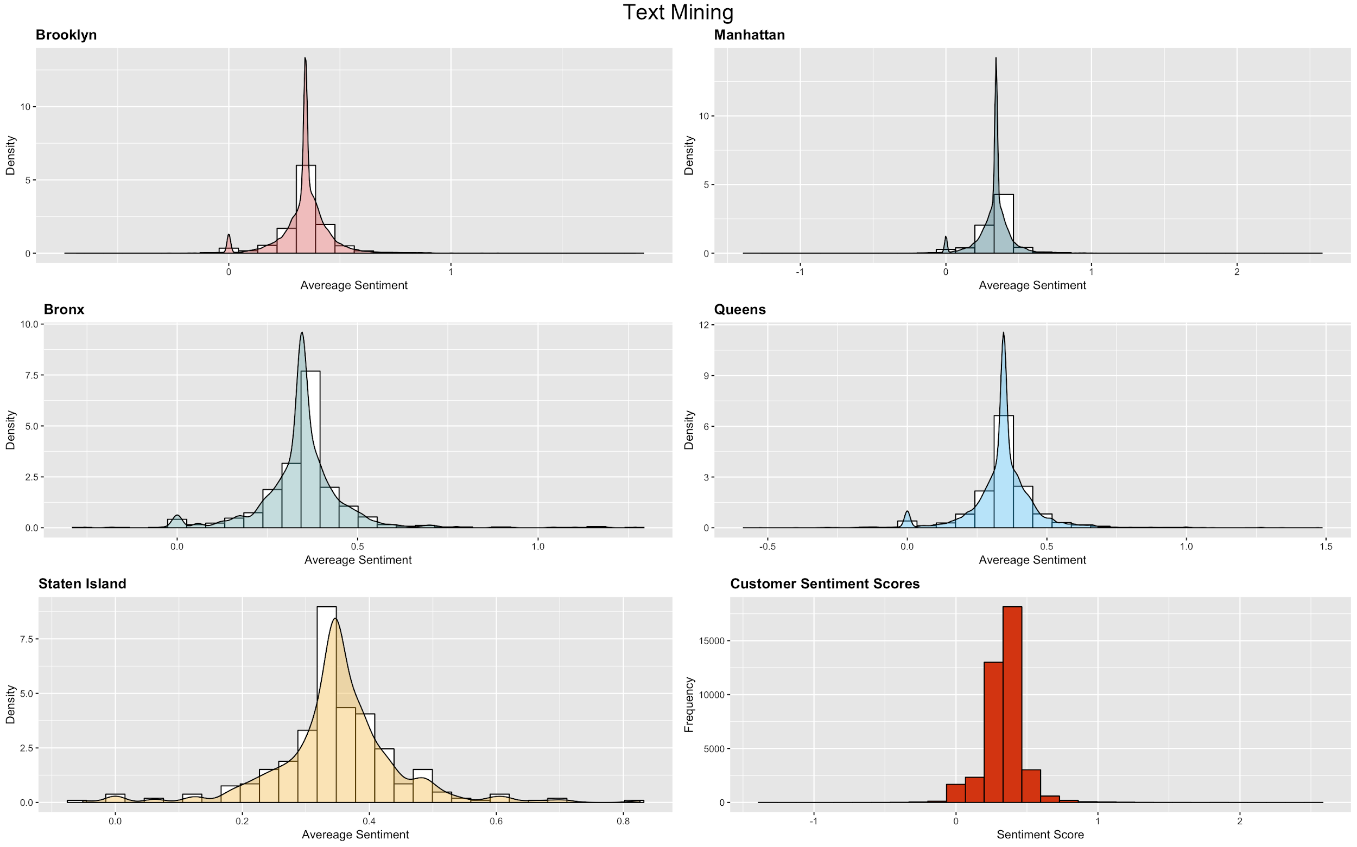

Slide 7
Data Cleaning and Preprocessing
Identified columns with missing data. Analysed, removed based on usability
Missing values replaced
Performed outlier detection & removal
Transformed Price & Accommodates (right skewed)
Notes:
with median

Slide 8
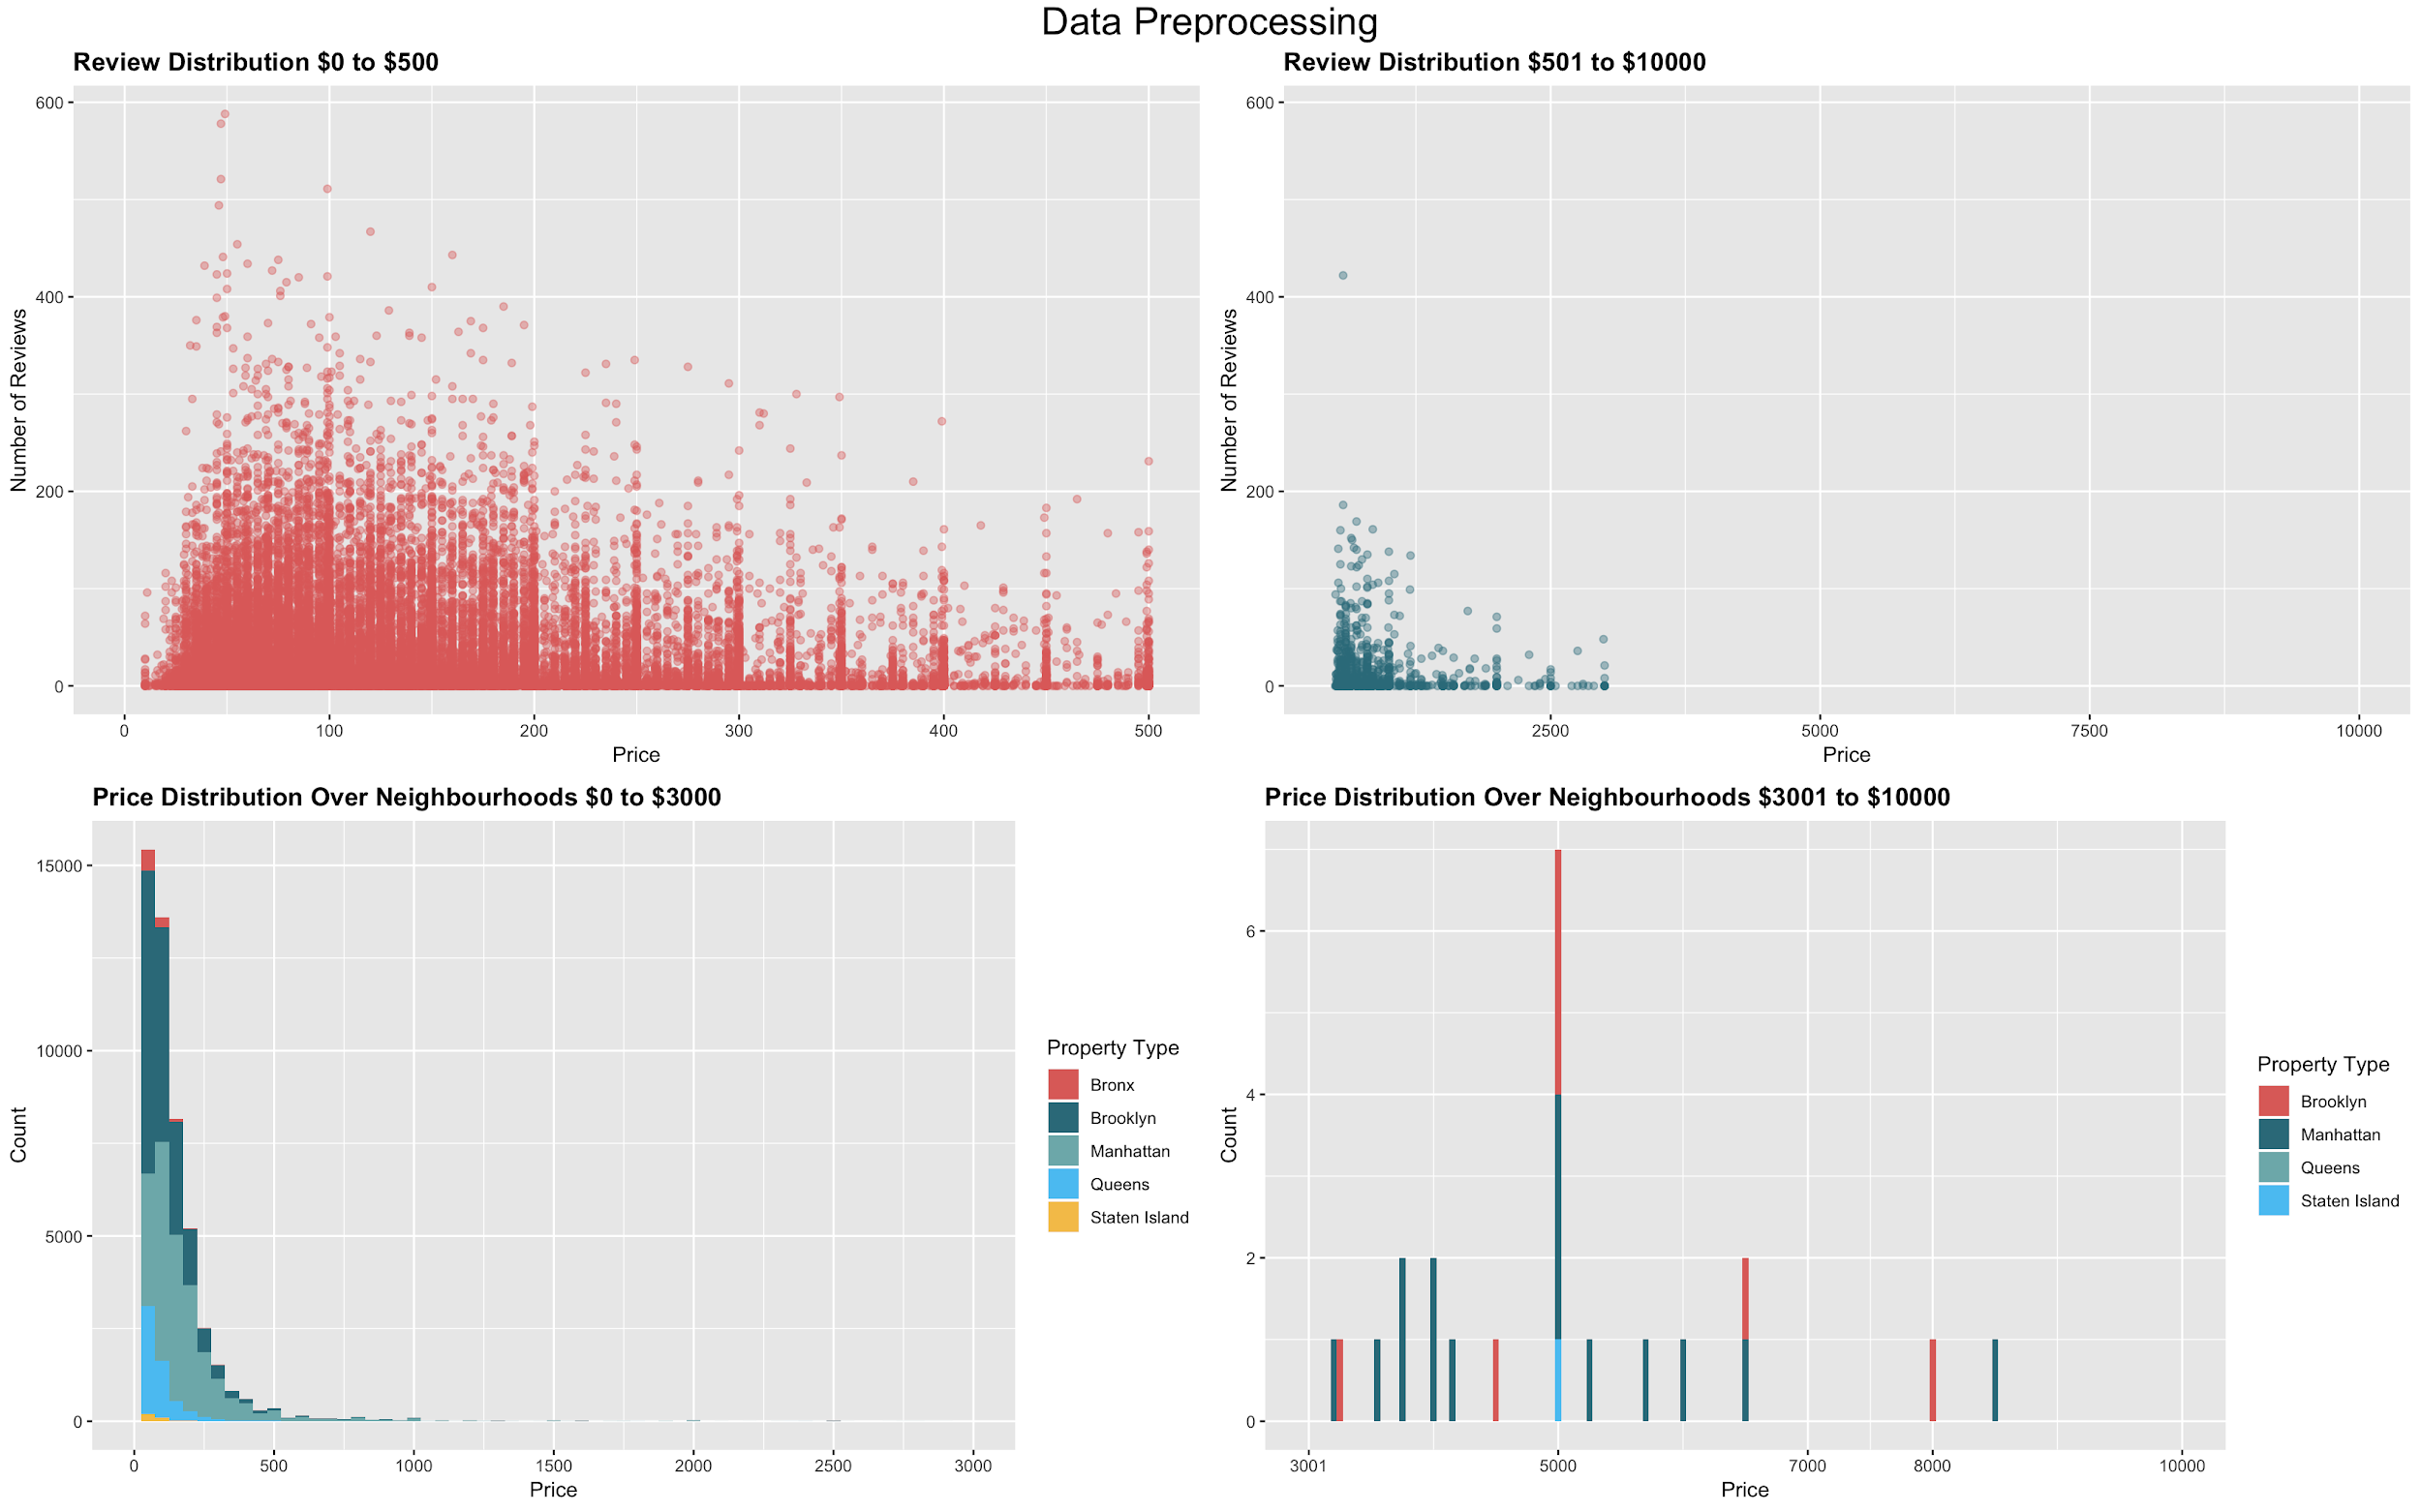

Slide 9
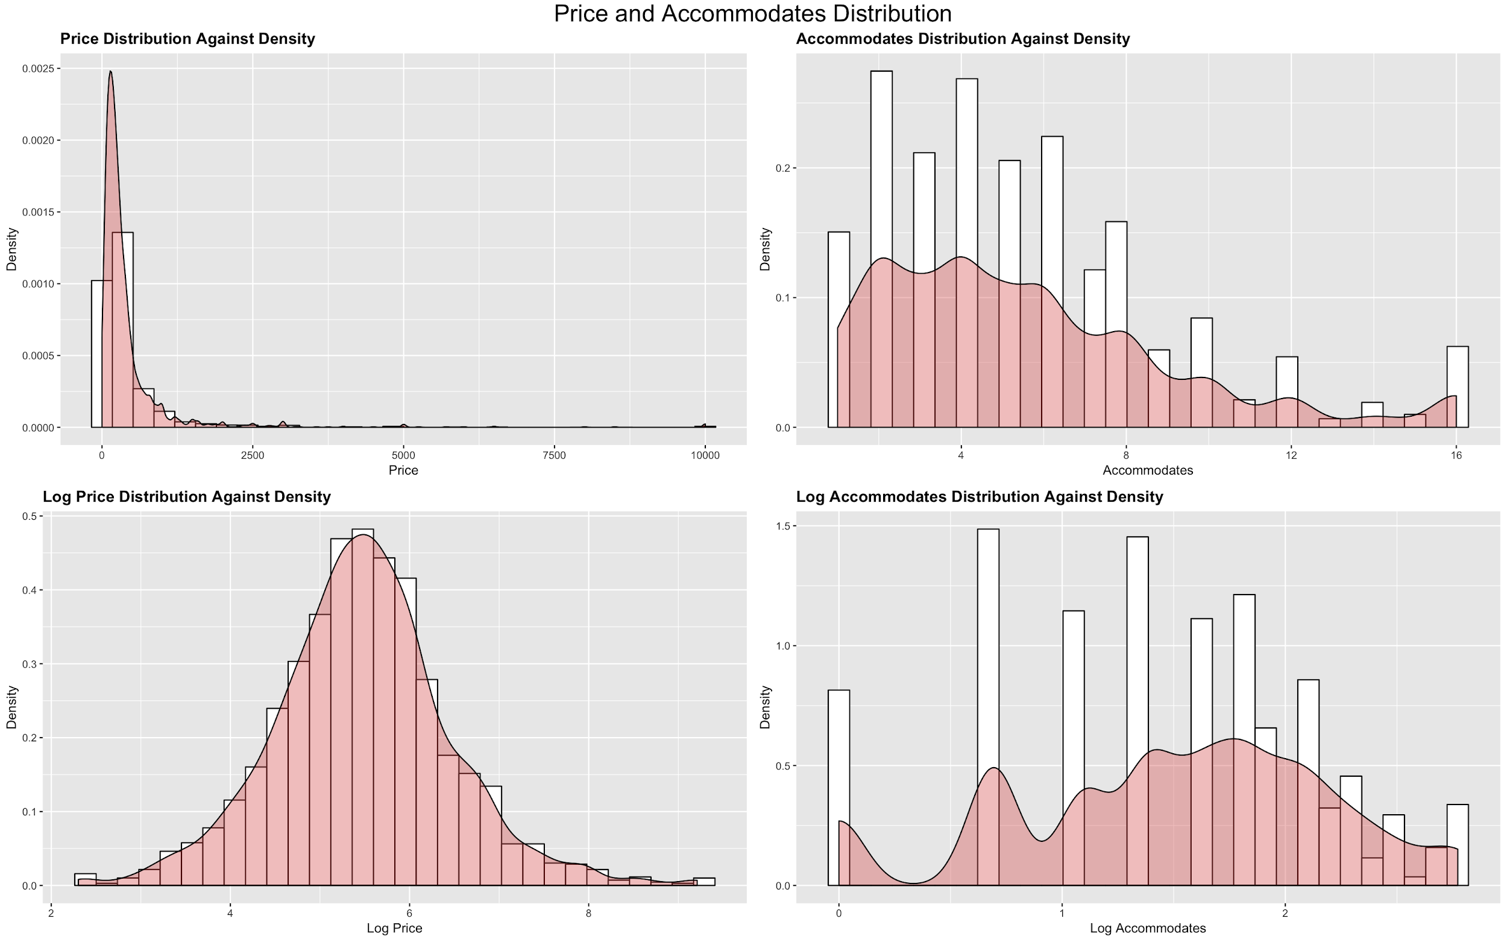

Slide 10
Data Mining Methodologies
MODEL | RMSE | MAE | MAPE | AE | ADJUSTED R²
Linear Regression | 126.45 | 59.34 | 47.88 | -1.44 | 0.3630
XG Boosting | 126.46 | 59.33 | 47.81 | -17.43 | 0.3860
Linear Regression (logged) | 126.76 | 50.51 | 32.15 | -1.42 | 0.6248
XG Boosting (logged) | 126.75 | 50.54 | 32.20 | -17.53 | 0.4150
Lasso Regression | 126.41 | 59.25 | 47.74 | -1.40 | 0.3860
Neural Net | 159.83 | 86.10 | 84.70 | -3.30 | -----

Slide 11
Result & Conclusion
All models underpredict houses
Linear model with logged variables 🏆
Most dependant on cancellation policy host response time property type cleaning fee security deposit review ratings total amenities sentiment score
Notes:
with median

Slide 12
Business Value Added
Advise
New hosts price houses ideally
Guests find underpriced deals
Investors on locations for higher returns
Notes:
with median

Slide 13

Thank You
Questions?

